Slide 1


<Name>
<Date>

Slide 2
Outline
Executive Summary
Introduction
Methodology
Results
Conclusion
Appendix

Slide 3

Executive Summary
In the upcoming capstone endeavor, our focus revolves around prognosticating the likelihood of a successful landing for the SpaceX Falcon 9 first stage through the employment of diverse machine learning classification methodologies.
The primary phases encompassed within this undertaking encompass:
Acquiring, refining, and structuring data
Engaging in exploratory data analysis
Crafting interactive data visualizations
Conducting machine learning-based prognostication
Our visual representations demonstrate correlations between certain attributes of rocket launches and their resultant outcomes, whether they be successes or failures.
It has been deduced that the decision tree algorithm emerges as a promising contender for predicting the successful landing of the Falcon 9 first stage.

Slide 4
Introduction
Project Background and Context:
The landscape of space exploration has witnessed significant transformations in recent years, marked by notable advancements in private space travel. Consequently, the space industry is progressively transitioning into a more mainstream and accessible realm for the general population.
Despite these strides, the cost of launch operations continues to pose a formidable barrier for potential entrants into the space race.
SpaceX, with its pioneering first stage reuse capabilities, enjoys a pivotal advantage over its competitors. While each SpaceX launch is estimated to cost approximately 62 million dollars, the company's ability to recycle the first stage for future launches confers a distinct edge. In contrast, other industry players expend upwards of 165 million dollars for each launch, lacking the cost-saving benefits of stage reuse.
Problems to Address:
Determine the likelihood of successful first stage landings for SpaceX Falcon 9 rockets.
Assess the impact of various parameters and variables on the outcomes of first stage landings. These variables may include launch site, payload mass, booster version, among others.
Investigate potential correlations between launch sites and the success rates of Falcon 9 rocket landings.

Slide 5

Section 1

Slide 6
Methodology
Executive Summary
Data collection methodology:
Describe how data was collected
Perform data wrangling
Describe how data was processed
Perform exploratory data analysis (EDA) using visualization and SQL
Perform interactive visual analytics using Folium and Plotly Dash
Perform predictive analysis using classification models
How to build, tune, evaluate classification models

Slide 7
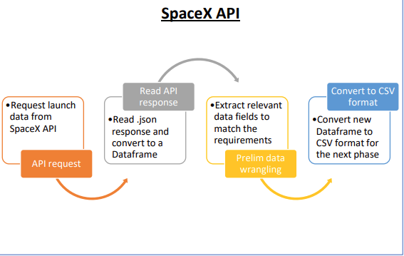
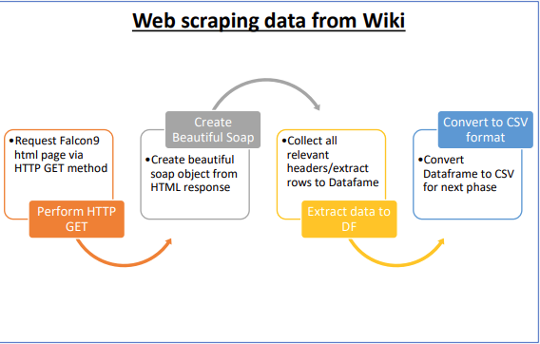
Data Collection
Data collection involves gathering data from various sources, which can be structured, unstructured, or semi-structured. In our project, we collected data using the SpaceX API and by scraping relevant launch data from Wikipedia pages.

Slide 8
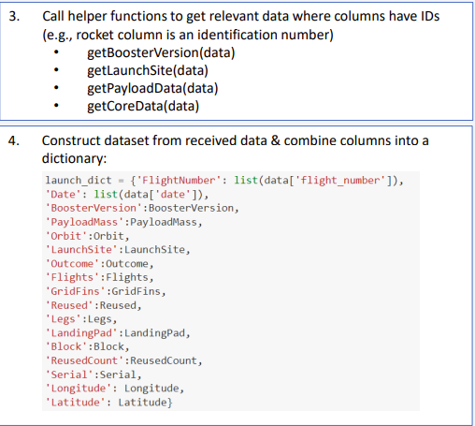
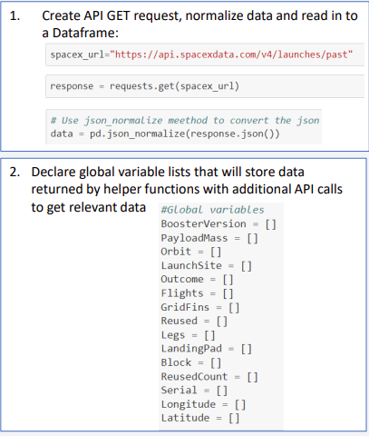
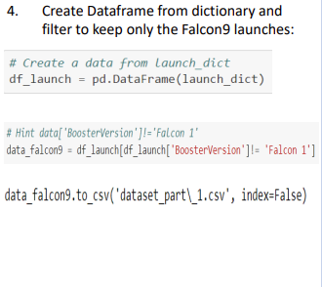
Data Collection – SpaceX API
GitHub: https://github.com/sombir1/Final-Project/blob/main/jupyter-labs-spacex-data-collection-api%20(1).ipynb

Slide 9
Data Collection - Scraping
GitHub: https://github.com/sombir1/Final-Project/blob/main/jupyter-labs-webscraping.ipynb
Fetching HTML content from Wikipedia
Employing BeautifulSoup with the html5lib Parser
Locating the HTML table containing launch information
Converting the obtained dictionary into a DataFrame
Iterating through the table cells to extract data and populate the dictionary
Generating a dictionary with the extracted data

Slide 10
Data Wrangling
• Conducted an Exploratory Data Analysis (EDA) to identify patterns within the dataset and establish labels for training supervised models. • The dataset encompassed diverse mission outcomes, which were transformed into Training Labels. A value of 1 indicated a successful booster landing, while 0 indicated an unsuccessful landing. The following landing scenarios were considered to formulate the labels:
True Ocean: Denoted a mission outcome successfully landed in a specific region of the ocean.
False Ocean: Indicated an unsuccessful landing in a specific region of the ocean.
RTLS (Return to Launch Site): Signified a successful landing on a ground pad.
False RTLS: Represented an unsuccessful landing attempt on a ground pad.
True ASDS (Autonomous Spaceport Drone Ship): Reflected a successful landing on a drone ship.
False ASDS: Corresponded to an unsuccessful landing attempt on a drone ship.
GitHub: https://github.com/sombir1/Final-Project/blob/main/labs-jupyter-spacex-Data%20wrangling%20(1).ipynb

Slide 11
EDA with Data Visualization
As part of the Exploratory Data Analysis (EDA), the following charts were generated to delve deeper into the dataset:
Scatter Plot:
A scatter plot displays the relationship or correlation between two variables, facilitating the observation of patterns.
The following charts were plotted to visualize:
Relationship between Flight Number and Launch Site
Relationship between Payload and Launch Site
Relationship between Flight Number and Orbit Type
Relationship between Payload and Orbit Type
Bar Chart:
Bar charts are effective for comparing the values of a variable at a specific point in time. They provide a clear visual representation of which groups are most common and how other groups compare.
The following bar chart was generated to visualize:
Relationship between the success rate of each orbit type
Line Chart:
Line charts are commonly used to track changes over a period of time, enabling the observation of trends.
The following line chart was plotted to observe:
Average launch success yearly trend
GitHub: https://github.com/sombir1/Final-Project/blob/main/edadataviz.ipynb

Slide 12
EDA with SQL
Unique Launch Sites:
The data analysis unveils the distinct launch sites contributing to the space mission.
Total Payload Mass by NASA (CRS):
The investigation yields the cumulative payload mass carried by boosters launched under NASA's CRS program.
Average Payload Mass of Booster Version F9 v1.1:
Insights reveal the mean payload mass transported by boosters of version F9 v1.1.
GitHub: https://github.com/sombir1/Final-Project/blob/main/jupyter-labs-eda-sql-coursera_sqllite.ipynb

Slide 13
Build an Interactive Map with Folium
Utilizing Folium interactive maps aids in analyzing geospatial data, enabling more engaging visual analytics and deeper insights into factors such as location and proximity of launch sites, which influence launch success rates.
Key elements were incorporated into the map object:
All launch sites were marked on the map to provide a visual representation.
'folium.circle' and 'folium.marker' were utilized to highlight circle areas with text labels over each launch site.
A 'MarkerCluster()' was added to display launch success (green) and failure (red) markers for each launch site, enhancing visual clarity.
Distances between launch sites and proximities (e.g., coastline, railroad, highway, city) were calculated and displayed.
'MousePosition()' was employed to retrieve coordinates for a mouse position over a point on the map.
'folium.Marker()' was added to indicate distances (in KM) on the map for various proximities (e.g., coastline, railroad, highway, city).
'folium.Polyline()' was used to draw lines between points on the map and the launch site, enhancing spatial understanding.
These interactive features facilitated answering pertinent questions:
Are launch sites in close proximity to railways? YES
Are launch sites in close proximity to highways? YES
Are launch sites in close proximity to the coastline? YES
Do launch sites maintain a certain distance from cities? YES
Overall, building the interactive map with Folium provided a comprehensive understanding of the spatial relationships between launch sites and various geographical features, aiding in the analysis of factors influencing launch success rates.
Github:https://github.com/sombir1/Final-Project/blob/main/lab_jupyter_launch_site_location.ipynb

Slide 14
Build a Dashboard with Plotly Dash
• Developed a Plotly Dash web application for interactive visual analytics on SpaceX launch data, featuring a Launch Site Drop-down, Pie Chart, Payload range slider, and Scatter chart.
Integrated a Launch Site Drop-down Input component, enabling filtering by all launch sites or a specific one.
Implemented a Pie Chart displaying total successful launches when 'All Sites' is selected, and success/failure counts for a chosen site.
Incorporated a Payload range slider for easy selection of different payload ranges to identify visual patterns.
Included a Scatter chart to explore payload correlation with mission outcomes for selected site(s), with Booster version color-labeled on each point.
• Dashboard insights addressed the following questions:
Which site has the largest successful launches? KSC LC-39A with 10.
Which site has the highest launch success rate? KSC LC-39A with 76.9% success.
Which payload range(s) has the highest launch success rate? 2000 – 5000 kg.
Which payload range(s) has the lowest launch success rate? 0-2000 and 5500 - 7000.
Which F9 Booster version (v1.0, v1.1, FT, B4, B5, etc.) has the highest launch success rate? FT.
Github: https://github.com/sombir1/Final-Project/blob/main/spacex_dash_app.py

Slide 15
Predictive Analysis (Classification)
When comparing the results of all four models side by side, it's evident that they all achieve the same accuracy score and confusion matrix when tested on the test set. Therefore, their GridSearchCV best scores are used to rank them. Based on the GridSearchCV best scores, the models are ranked as follows, with the best model listed first and the worst model listed last:
Decision Tree (GridSearchCV best score: 0.8892857142857142)
K Nearest Neighbors, KNN (GridSearchCV best score: 0.8482142857142858)
Support Vector Machine, SVM (GridSearchCV best score: 0.8482142857142856)
Logistic Regression (GridSearchCV best score: 0.8464285714285713)
GitHub:https://github.com/sombir1/Final-Project/blob/main/SpaceX_Machine%20Learning%20Prediction_Part_5.ipynb

Slide 16
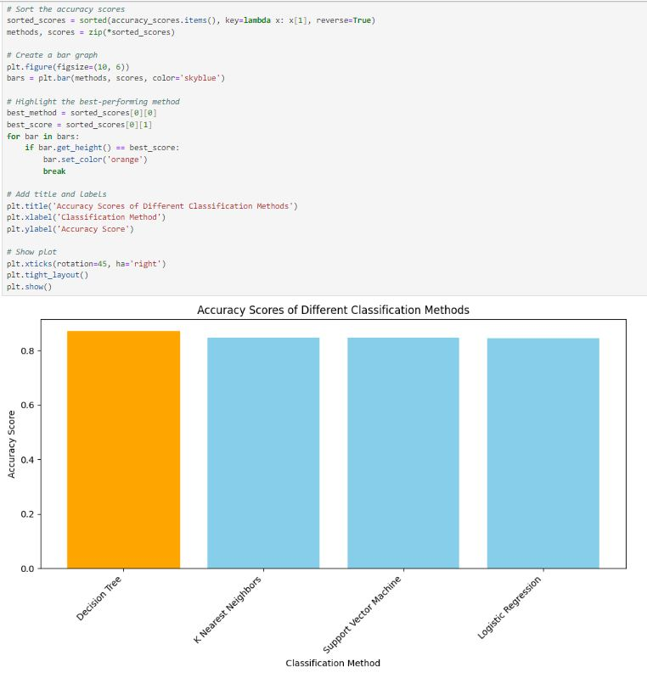
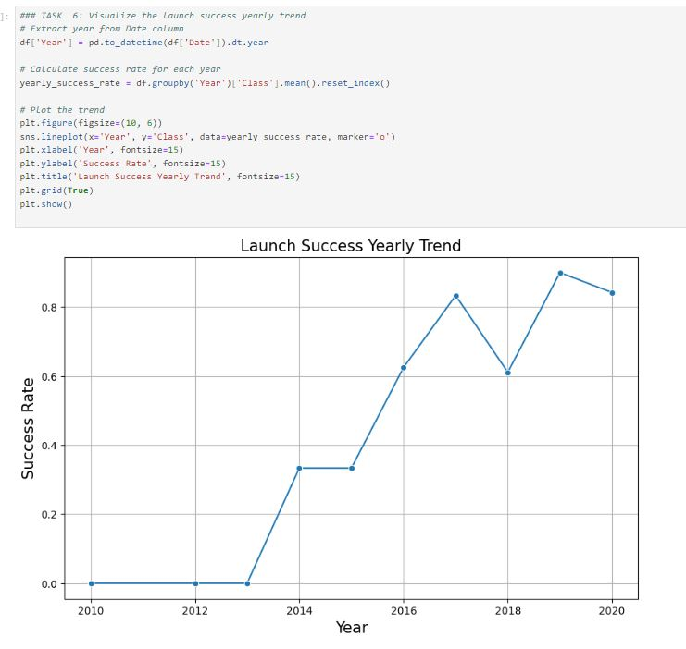
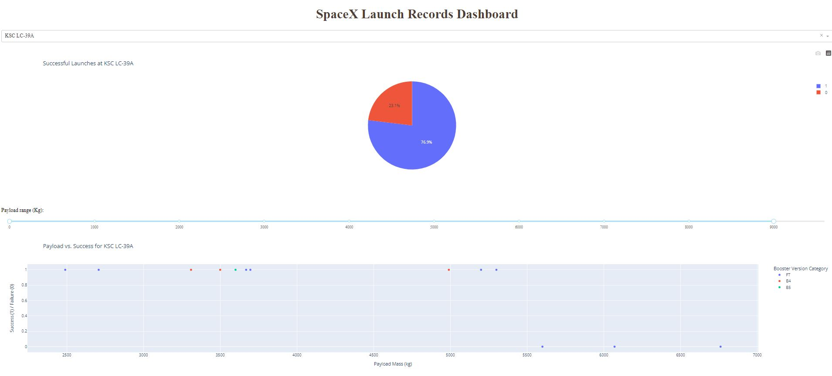
Results
Exploratory data analysis results
Interactive analytics demo in screenshots
Predictive analysis results

Slide 17

Section 2

Slide 18
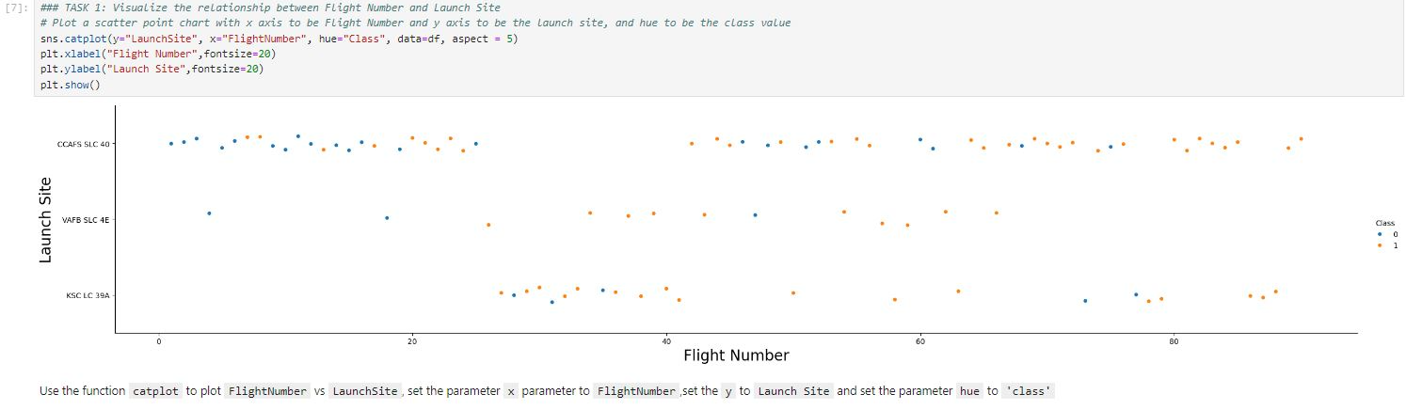
Flight Number vs. Launch Site
The success rates (Class=1) demonstrate an increase as the number of flights increases.
Specifically, for launch site 'KSC LC 39A', it typically requires approximately 25 launches before achieving the first successful launch.

Slide 19
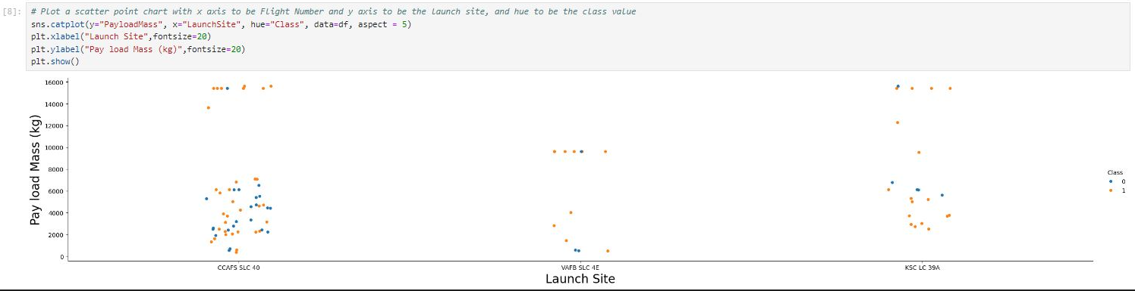
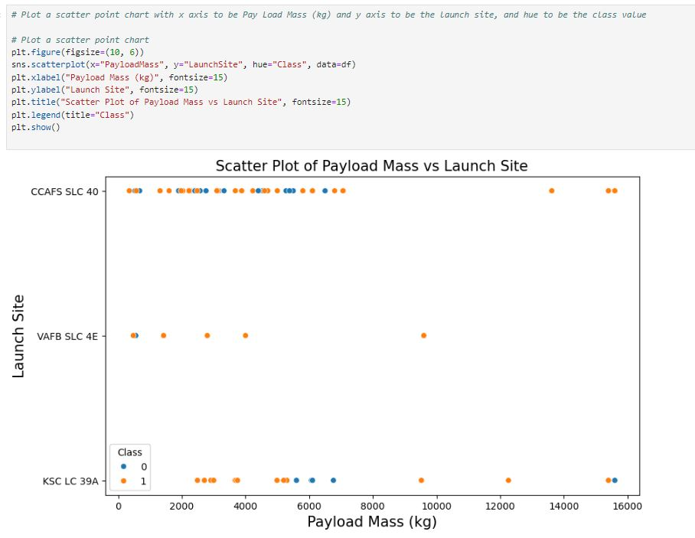
Payload vs. Launch Site
At launch site 'VAFB SLC 4E', no rockets are launched for payloads greater than 10,000 kg.
The percentage of successful launches (Class=1) at launch site 'VAFB SLC 4E' tends to increase as the payload mass increases.
There is no discernible correlation or pattern observed between launch site and payload mass.

Slide 20
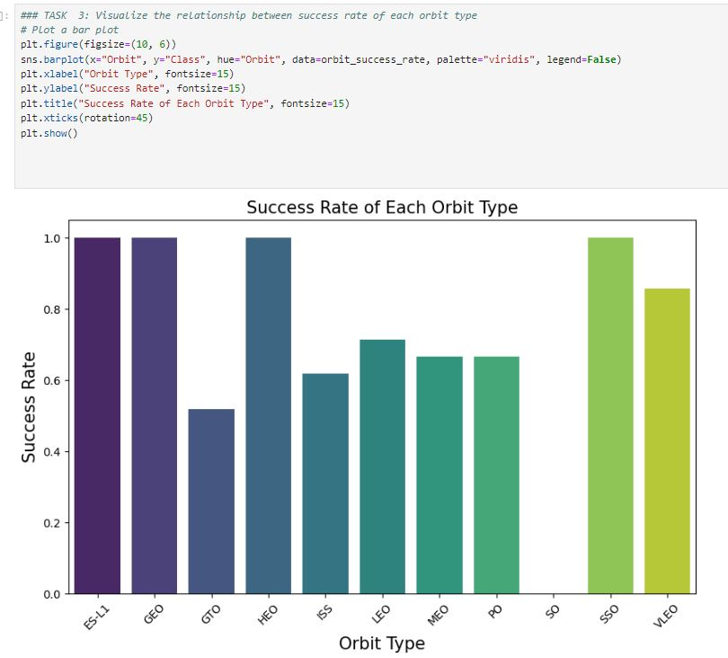
Success Rate vs. Orbit Type
Orbits ES-LI, GEO, HEO, and SSO exhibit the highest success rates.
Conversely, the GTO orbit demonstrates the lowest success rate.

Slide 21
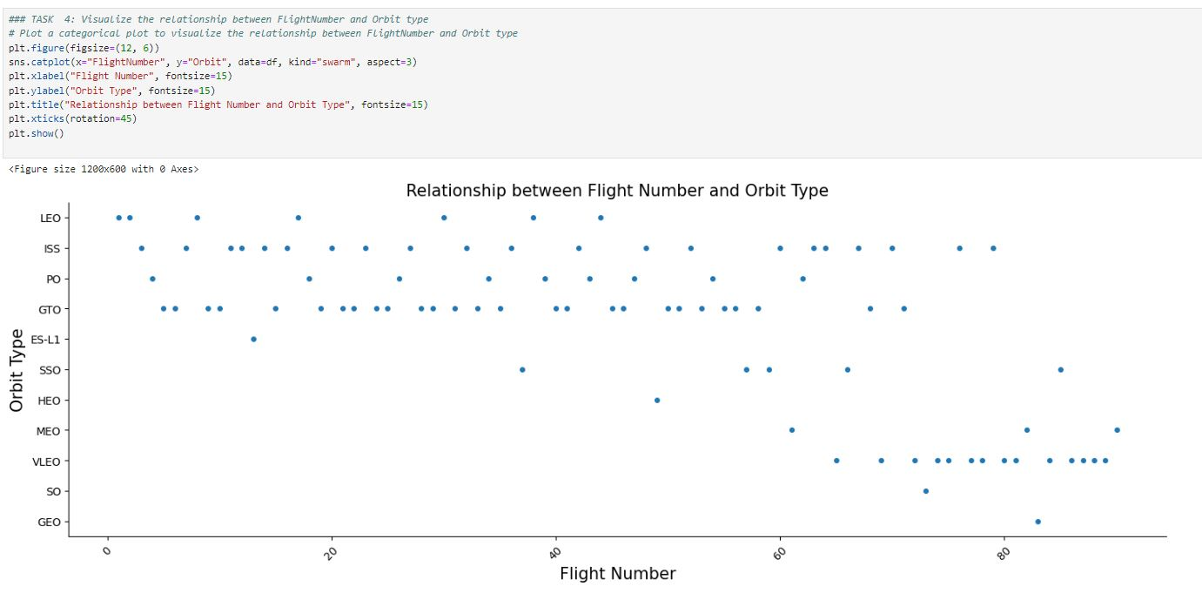
Flight Number vs. Orbit Type
In orbit VLEO, the first successful landing (class=1) typically doesn't occur until after 60 flights.
Across most orbits (LEO, ISS, PO, SSO, MEO, VLEO), successful landing rates generally increase with flight numbers.
However, there appears to be no discernible relationship between flight number and orbit for GTO.

Slide 22
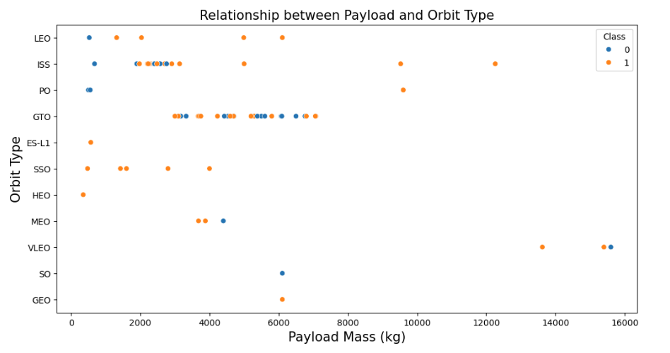
Payload vs. Orbit Type
Successful landing rates (Class=1) show an apparent increase with payload for orbits LEO, ISS, PO, and SSO.
Conversely, for the GEO orbit, there is no clear pattern observed between payload and orbit for either successful or unsuccessful landings.

Slide 23
Launch Success Yearly Trend
The success rate (Class=1) witnessed a significant increase of approximately 80% between 2013 and 2020.
Success rates remained stable between 2010 and 2013 and between 2014 and 2015.
However, there was a decrease in success rates between 2017 and 2018, as well as between 2019 and 2020.

Slide 24
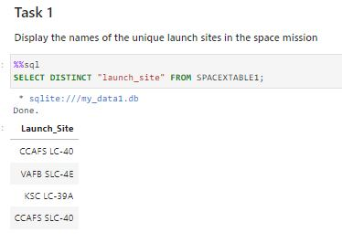
All Launch Site Names
Description:
Utilizing the 'distinct' function retrieves only unique values from the queries column, specifically Launch_Site.
Analysis reveals a total of 4 unique launch sites.

Slide 25
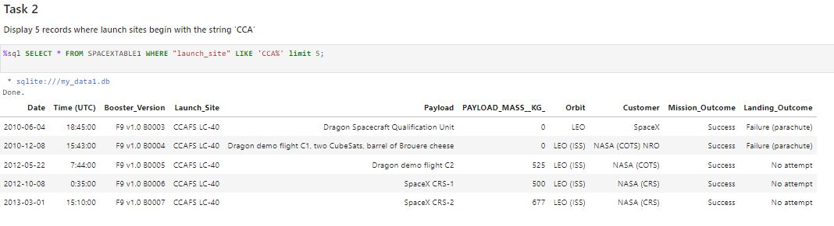
Launch Site Names Begin with 'CCA'
Description:
Employing the keyword 'Like' with the format 'CCA%' retrieves records where the 'Launch_Site' column commences with "CCA".
The addition of 'Limit 5' restricts the number of returned records to 5.

Slide 26
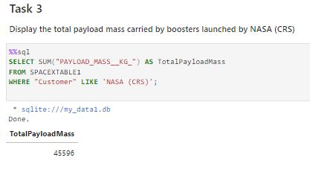
Total Payload Mass
Description:
The function 'sum' computes the sum of the 'PAYLOAD_MASS_KG' column.
Specifically, it returns the total payload mass for customers designated as 'NASA (CRS)'.

Slide 27
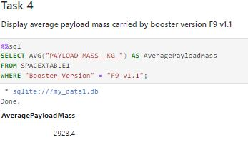
Average Payload Mass by F9 v1.1
Description:
Utilizing the 'avg' keyword calculates the average payload mass in the 'PAYLOAD_MASS_KG' column.
This calculation specifically focuses on instances where the booster version is 'F9 v1.1'.

Slide 28
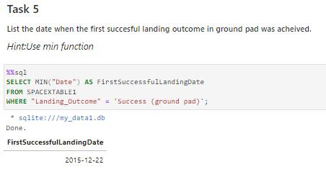
First Successful Ground Landing Date
Description:
The expression 'min(Date)' selects the earliest date from the 'Date' column where the first successful landing on a ground pad occurred.
The 'Where' clause specifies the condition to retrieve the date for instances where the 'Landing_Outcome' value equals 'Success (ground pad)'.

Slide 29
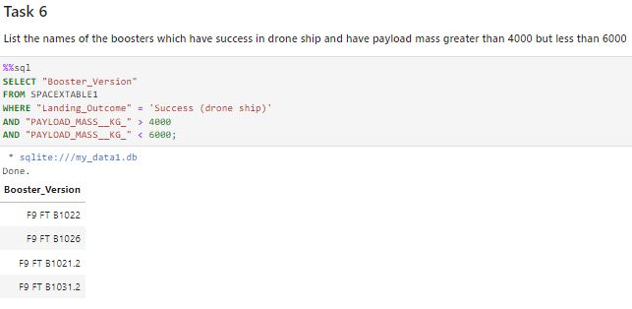
Successful Drone Ship Landing with Payload between 4000 and 6000
Description:
This query identifies the booster versions where the payload mass is greater than 4000 but less than 6000, and the landing outcome is successful on a drone ship.
The 'and' operator in the 'where' clause ensures that only booster versions meeting both conditions are returned.

Slide 30
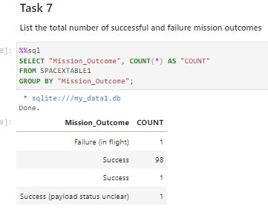
Total Number of Successful and Failure Mission Outcomes
Description:
The 'group by' keyword organizes identical data in a column into groups.
Specifically, the number of mission outcomes is grouped by types of outcomes in the 'counts' column.

Slide 31
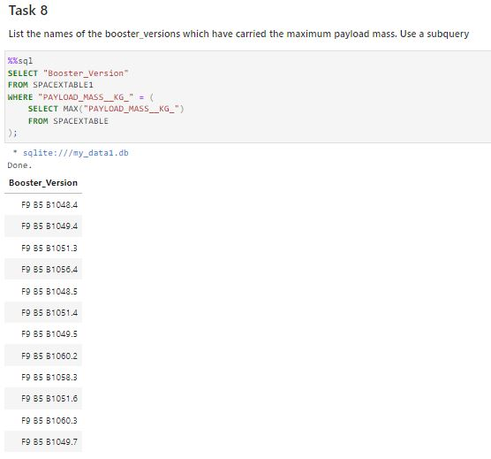
Boosters Carried Maximum Payload
Description:
The subquery retrieves the maximum payload mass using the 'max' keyword on the payload mass column.
In the main query, the booster versions and their corresponding payload masses are returned where the payload mass equals the maximum value of 15600.

Slide 32
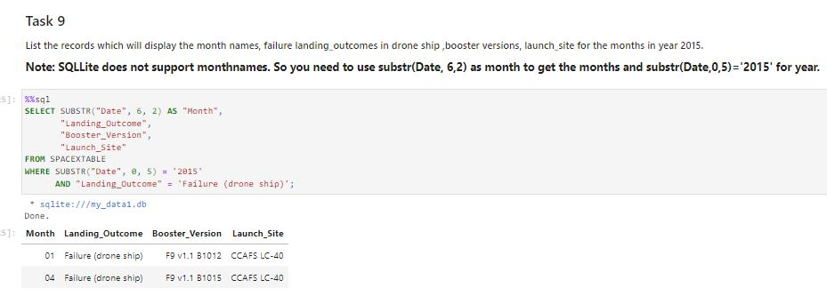
2015 Launch Records
Description:
The query lists the landing outcome, booster version, and launch site where the landing outcome is a failure on a drone ship in the year 2015.
The 'and' operator in the where clause ensures that both conditions are met for the returned results.
The 'year' keyword extracts the year from the 'Date' column.
The results identify the launch site as 'CCAFS LC-40' and the booster versions as F9 v1.1 B1012 and B1015, which experienced failed landing outcomes on a drone ship in the year 2015.

Slide 33
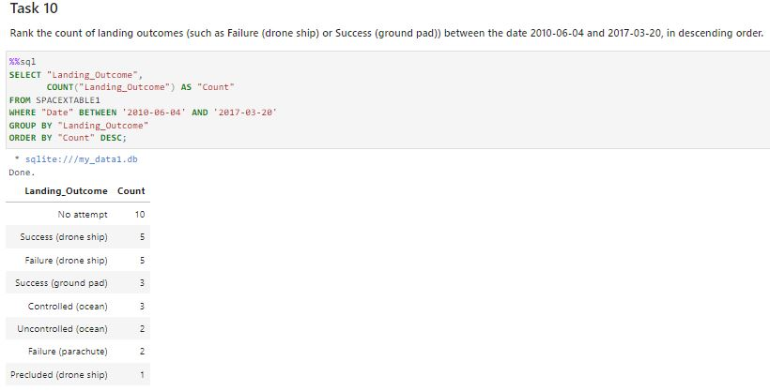
Rank Landing Outcomes Between 2010-06-04 and 2017-03-20
Description:
The 'group by' keyword organizes data in the 'Landing_Outcome' column into groups.
The 'between' and 'and' keywords filter data between the dates 2010-06-04 and 2017-03-20.
The 'order by' keyword sorts the counts column in descending order.
The query yields a ranked list of landing outcome counts per the specified date range.

Slide 34

Section 3

Slide 35
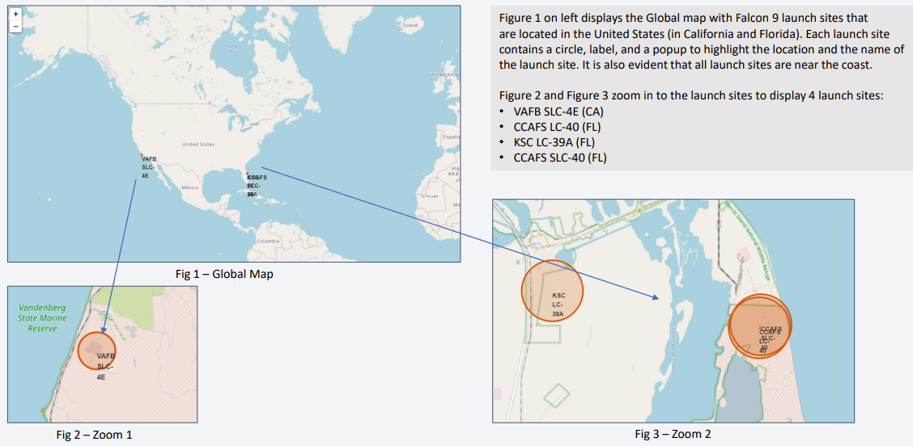
SpaceX Falcon9 - Launch Sites Map

Slide 36
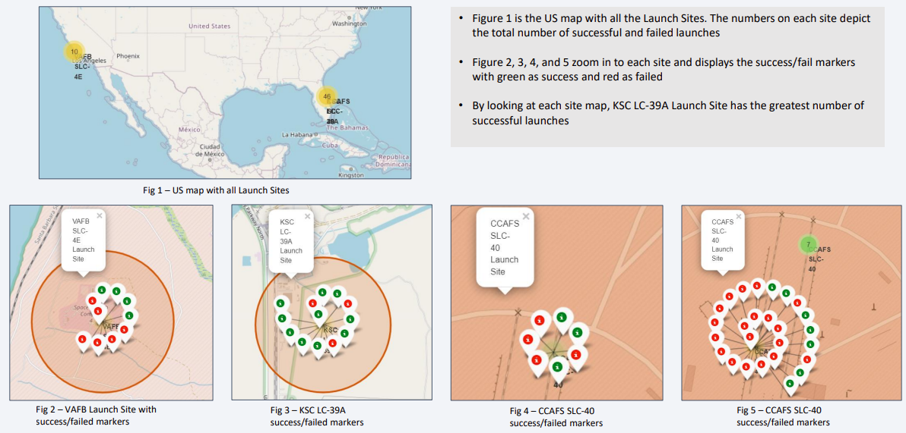
SpaceX Falon9 – Success/Failed Launch Map for all Launch Sites

Slide 37
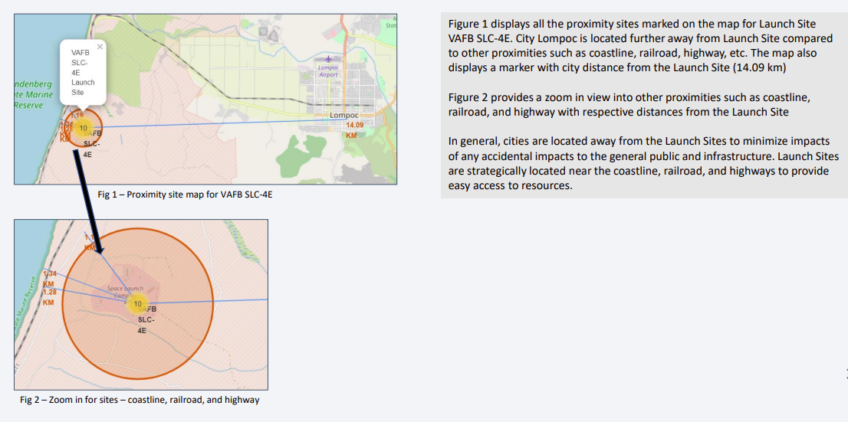
SpaceX Falcon9 – Launch Site to proximity Distance Map

Slide 38

Section 4

Slide 39
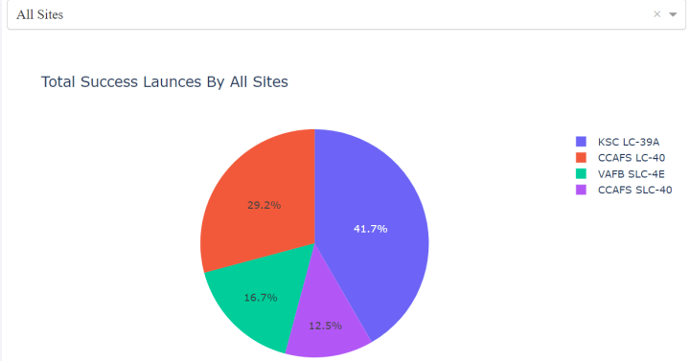
Launch Success Counts For All Sites
Launch Site 'KSC LC-39A' boasts the highest launch success rate.
Conversely, Launch Site 'CCAFS SLC-40' exhibits the lowest launch success rate.

Slide 40
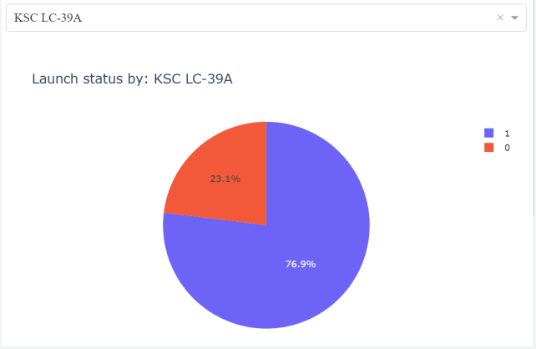
Launch Site with Highest Launch Success Ratio
The KSC LC-39A Launch Site achieves both the highest launch success rate and count.
The launch success rate stands at 76.9%.
Meanwhile, the launch failure rate is 23.1%.

Slide 41
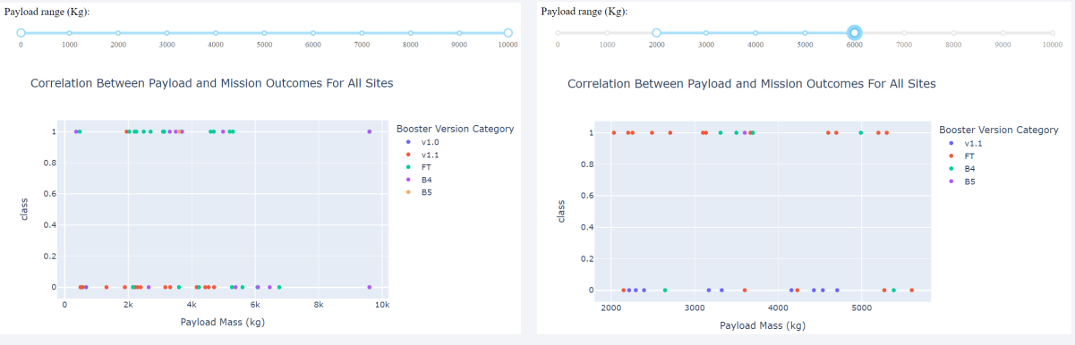
The majority of successful launches fall within the payload range from 2000 to approximately 5500.
Among booster version categories, 'FT' records the highest number of successful launches.
Interestingly, the only booster with a successful launch when the payload exceeds 6000 kg is 'B4'.
Payload vs. Launch Outcome Scatter Plot for All Sites

Slide 42

Section 5

Slide 43
Classification Accuracy
The Decision Tree algorithm achieves the highest classification score of 0.8750, as indicated by the Accuracy scores and confirmed by the bar chart.
The Accuracy Score remains consistent across all classification algorithms on the test data, with a value of 0.8333.
Since the Accuracy scores for classification algorithms are very close and the test scores are identical, it suggests the necessity of a broader dataset for further model tuning.

Slide 44
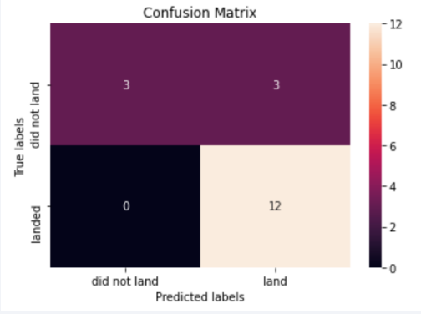
Confusion Matrix
The confusion matrix remains consistent across all models (LR, SVM, Decision Tree, KNN).
According to the confusion matrix, the classifier made a total of 18 predictions.
Out of these, 12 scenarios were predicted as 'Yes' for landing, and they did land successfully (True positive).
Additionally, 3 scenarios were correctly predicted as 'No' for landing, and they did not land (True negative).
However, there were also 3 scenarios where the classifier predicted 'Yes' for landing, but they did not land successfully (False positive).
Overall, the classifier's accuracy is approximately 83% ((TP + TN) / Total), with a misclassification or error rate of about 16.5% ((FP + FN) / Total).

Slide 45
Conclusions
With an increase in the number of flights, the first stage is more likely to land successfully.
While success rates tend to rise with increasing payload, there's no clear correlation between payload mass and success rates.
The launch success rate surged by approximately 80% from 2013 to 2020.
KSC LC-39A boasts the highest launch success rate, whereas CCAFS SLC-40 has the lowest.
Orbits ES-L1, GEO, HEO, and SSO exhibit the highest launch success rates, while GTO has the lowest.
Launch sites are strategically located away from cities and closer to coastline, railroads, and highways.
The Decision Tree emerges as the best-performing Machine Learning Classification Model with an accuracy of about 87.5%. However, all models achieved an accuracy score of about 83% when scored on the test data. Further data may be required for fine-tuning the models and potentially finding a better fit.

Slide 46
Appendix
Github: Repository URL: https://github.com/sombir1/Final-Project
Special Thanks to Coursera!!

Slide 47


